Slide 1


<Your Program Name>
<Program mission or vision statement>
<Program dates>
<Replace with your logo(s) above>
Making every interaction count with LENA Grow
Notes:
This deck is designed to help you present and celebrate your LENA Grow program outcomes with your community:
A suggested script is provided in the notes section of each slide.
Italicized text provides reference or background information.
<Text in brackets> indicates, either on the slide or in the notes, an opportunity to customize this presentation with your own program results, successes, and outcomes.
Keep slide content light — use your conversation to tell the whole story and presentation slides to support.
Delete all unnecessary slides (and slide notes) when customizations are finished. Some slides may be more effective than others depending on your target audience.
<Thank you for joining the discussion today. I'm excited to share more with you about our work with LENA Grow and how it supports our mission of...>

Slide 2
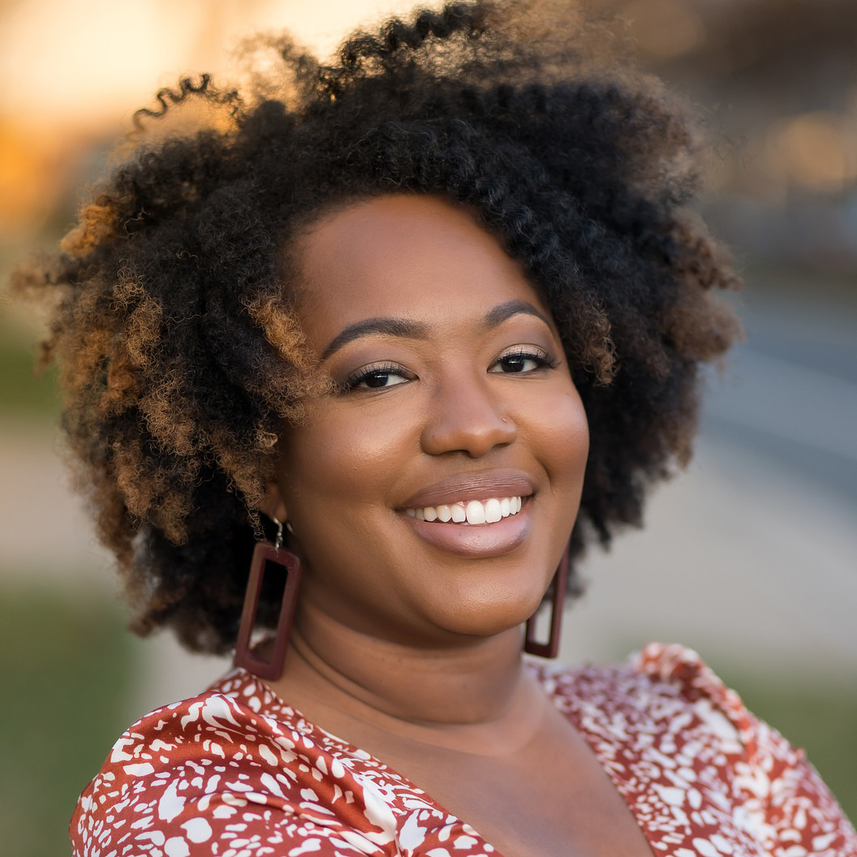
<Quote from coach, teacher, or other LENA Grow staff>
Name of staff member
Job title/position
Replace or delete!
Notes:
We recommend opening your presentation with a quote from a LENA Grow coach, teacher, or center director who is making every interaction count in your community. Consider adding a photo of the person or their classroom for maximum impact.
To set the stage for our conversation today, I'd like to open with a quote from one of our program participants.

Slide 3

What is LENA Grow?
A professional development program for early childhood educators that...
Increases teacher-child interaction.
Boosts children's social-emotional development and language skills.
Focuses on classroom equity.
Supports future school success.
Increases teacher job satisfaction.
Notes:
Read slide.

Slide 4
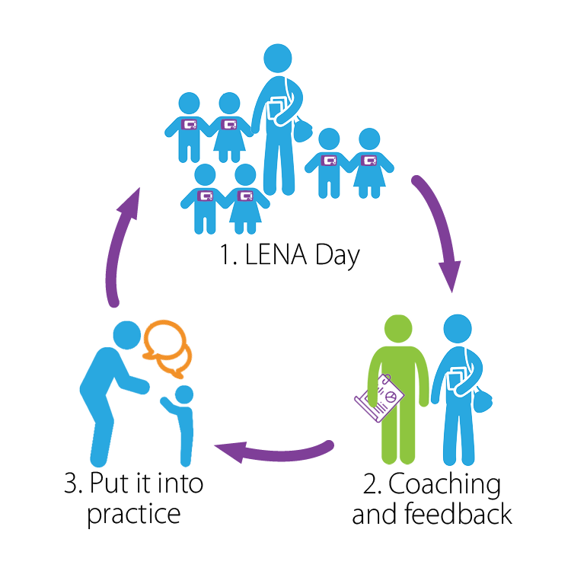
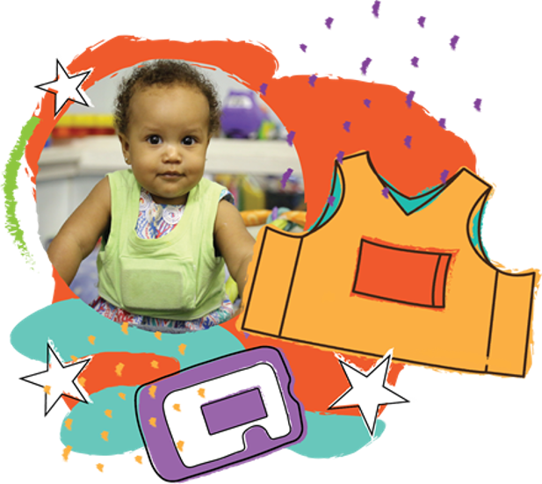
How Does LENA Grow Work?
Notes:
The LENA Grow program uses data from LENA technology, weekly coaching sessions, and program materials to help build more talk into daily classroom activities. LENA's feedback cycle supports educators in making long-lasting changes to language interactions.
Each week, children wear a vest containing a LENA device. The device captures the talk each child experiences during the day. This data is processed and turned into a data report. Teachers and coaches use these reports to discuss program successes, challenges, set a target goal, and learn new talk strategies.
Teachers are then able to work towards achieving their target goals, practicing engaging children in quality classroom talk until the next LENA Day.

Slide 5
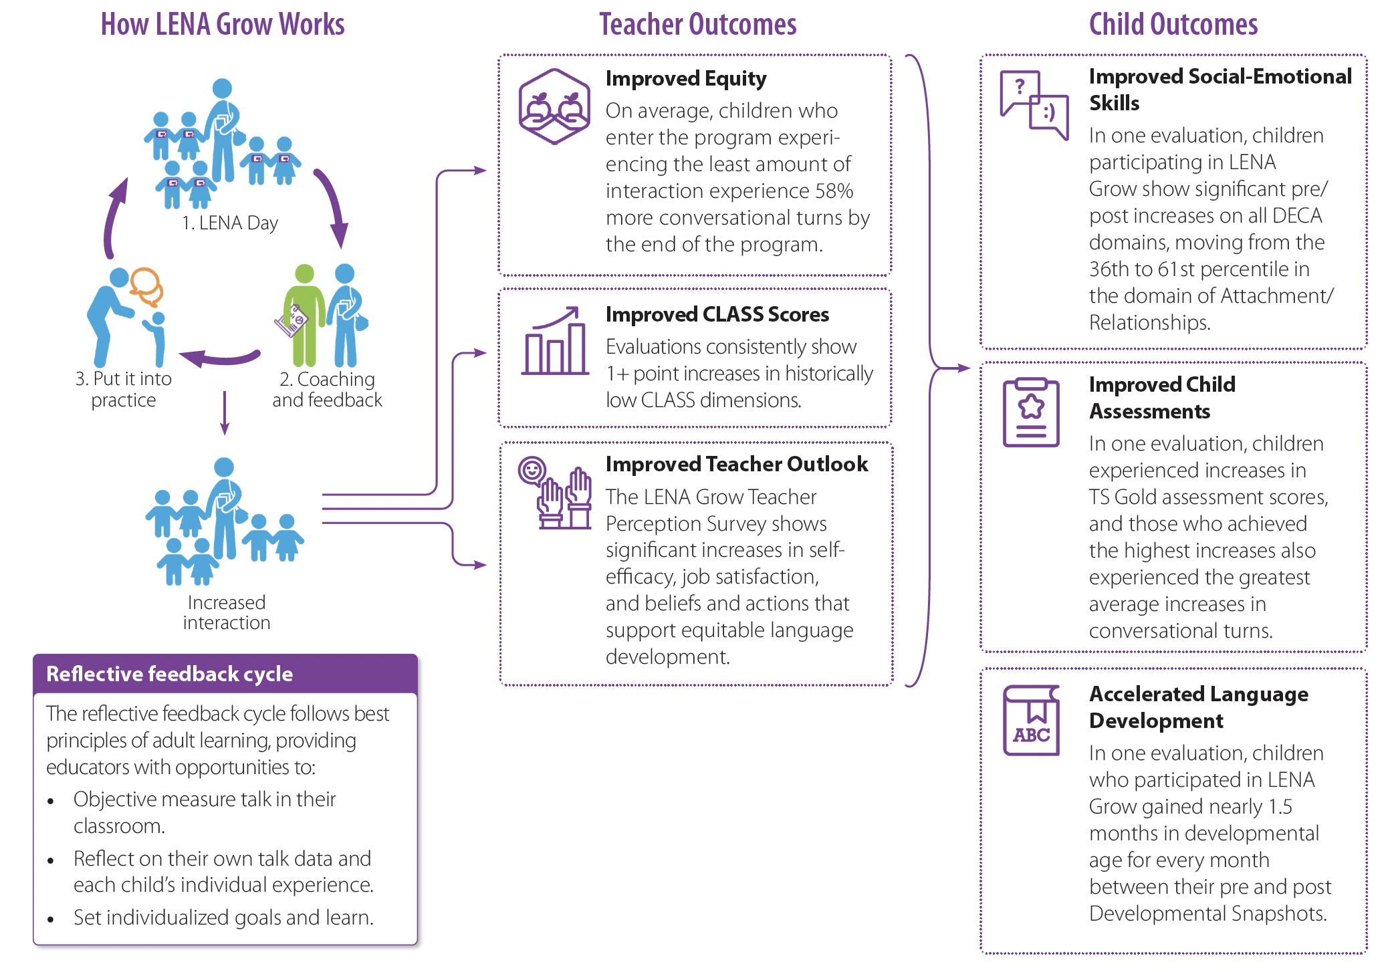






LENA Grow Outcomes
Teacher Outcomes
Child Outcomes
Improved Equity
Increased Assessment Scores
Improved Social-emotional Skills
Improved Child Assessments
More Positive Teacher Outlook
Accelerated Language Development
Notes:
These changes in language interactions result in so many positive teacher and child outcomes. Multiple independent program evaluations have proven this to be true, so LENA Grow is officially what we can call an "evidence-based" program.
Teacher outcomes:
Improved classroom equity: On average, children who enter the program experiencing the least amount of interaction experience 58% more conversational turns by the end of the program.
Increased CLASS Scores: Evaluations consistently show notable improvements in historically low CLASS dimensions.
More Positive Teacher Outlook: LENA Grow Teacher Perception Survey shows significant increases in self-efficacy, job satisfaction, and beliefs and actions that support equitable language development. That includes a reduction in teacher stress.
Child outcomes:
Improved social-emotional skills: In one evaluation, children participating in LENA Grow show significant pre/post increase on all DECA domains, moving from the 36th to 61st percentile in the domain of Attachment/Relationships.
Improved Child Assessments: In several evaluations, children experienced increases in TS Gold assessment scores, and those who achieved the highest increases also experienced the greatest average increases in conversational turns.
Accelerated Language Development: In one evaluation, children who participated in LENA Grow gained nearly 1.5 months in developmental age for every month between their pre and post Developmental Snapshots.

Slide 6
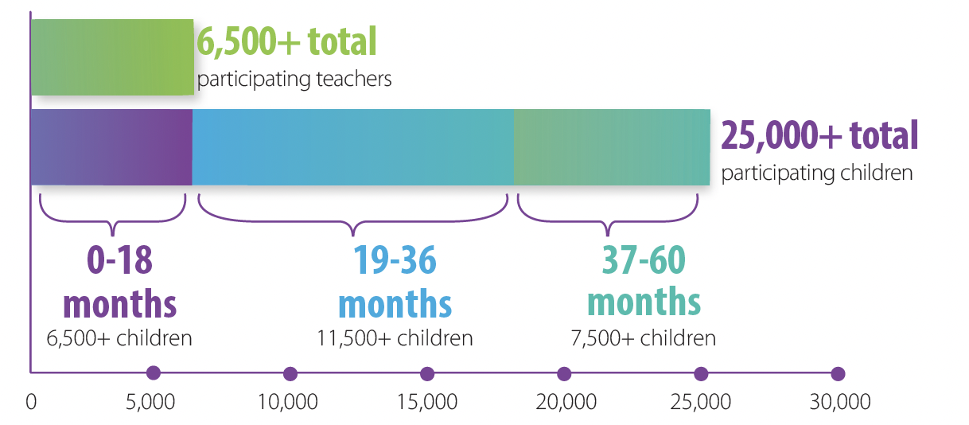
Program Outcomes
Notes:
We are a part of something great! Since 2016, more than 6,500 educators and 25,000 children have participated in LENA Grow, in 32 states and Washington D.C., as well as Australia and New Zealand.

Slide 7

<Program Title>
<1-2 sentence description of your program.>
<How does LENA Grow help achieve your program mission?>
<Key feature #1>
<Key feature #2>
Notes:
Introduce and explain your specific program to stakeholders/fundraisers.
Why did you choose to implement the LENA Grow program?
How does the work you do effectively achieve your mission?
Emphasize one or two key features or insights.

Slide 8



Program Milestones
Start date
<Oct, 2020>​
2nd sequence <mo, year>​
3rd sequence <mo, year>
Notes:
Milestone journey (3 steps)
Add any other milestones of interest. Did you partner with any community organizations? Host or participate in any community events?
Other LENA Grow partner examples:
• Hosting podcast.
• Introducing new community resources.
• Summer programs for families.

Slide 9



Program Outcomes
<This year>, we reached:
<150>
<38>
<20>
Children
Teachers
Classrooms
<Summarize program as related to any grant/other requirements.>
Notes:
Think about your statistical data: who you serve, who used the program, what your program provides your community.

Slide 10
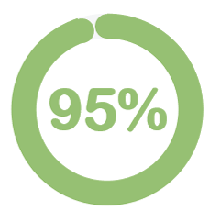
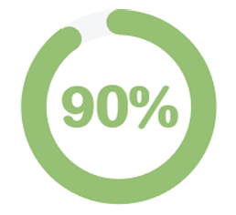
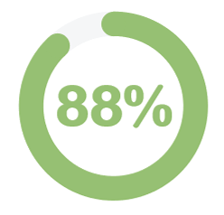
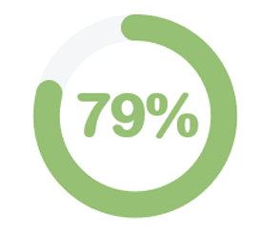
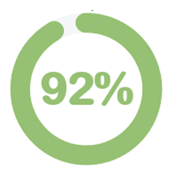
Program Outcomes
Recommend LENA Grow to other teachers.
Feel more confident in their teaching abilities.
Increased overall job satisfaction.
Increased communication with families.
Saw changes in children’s language development.
Notes:
Showcase any positive outcomes from your program's Impact Report.
LENA Grow is a powerful professional-development program for teachers. Program survey data overwhelmingly show:
<x> percent recommend LENA Grow to other teachers.
<x> percent feel more confident in their teaching abilities.
<x> percent increased overall job satisfaction.
<x> percent saw changes in the language development of the children in their room.
All of this in just five, short weeks!

Slide 11
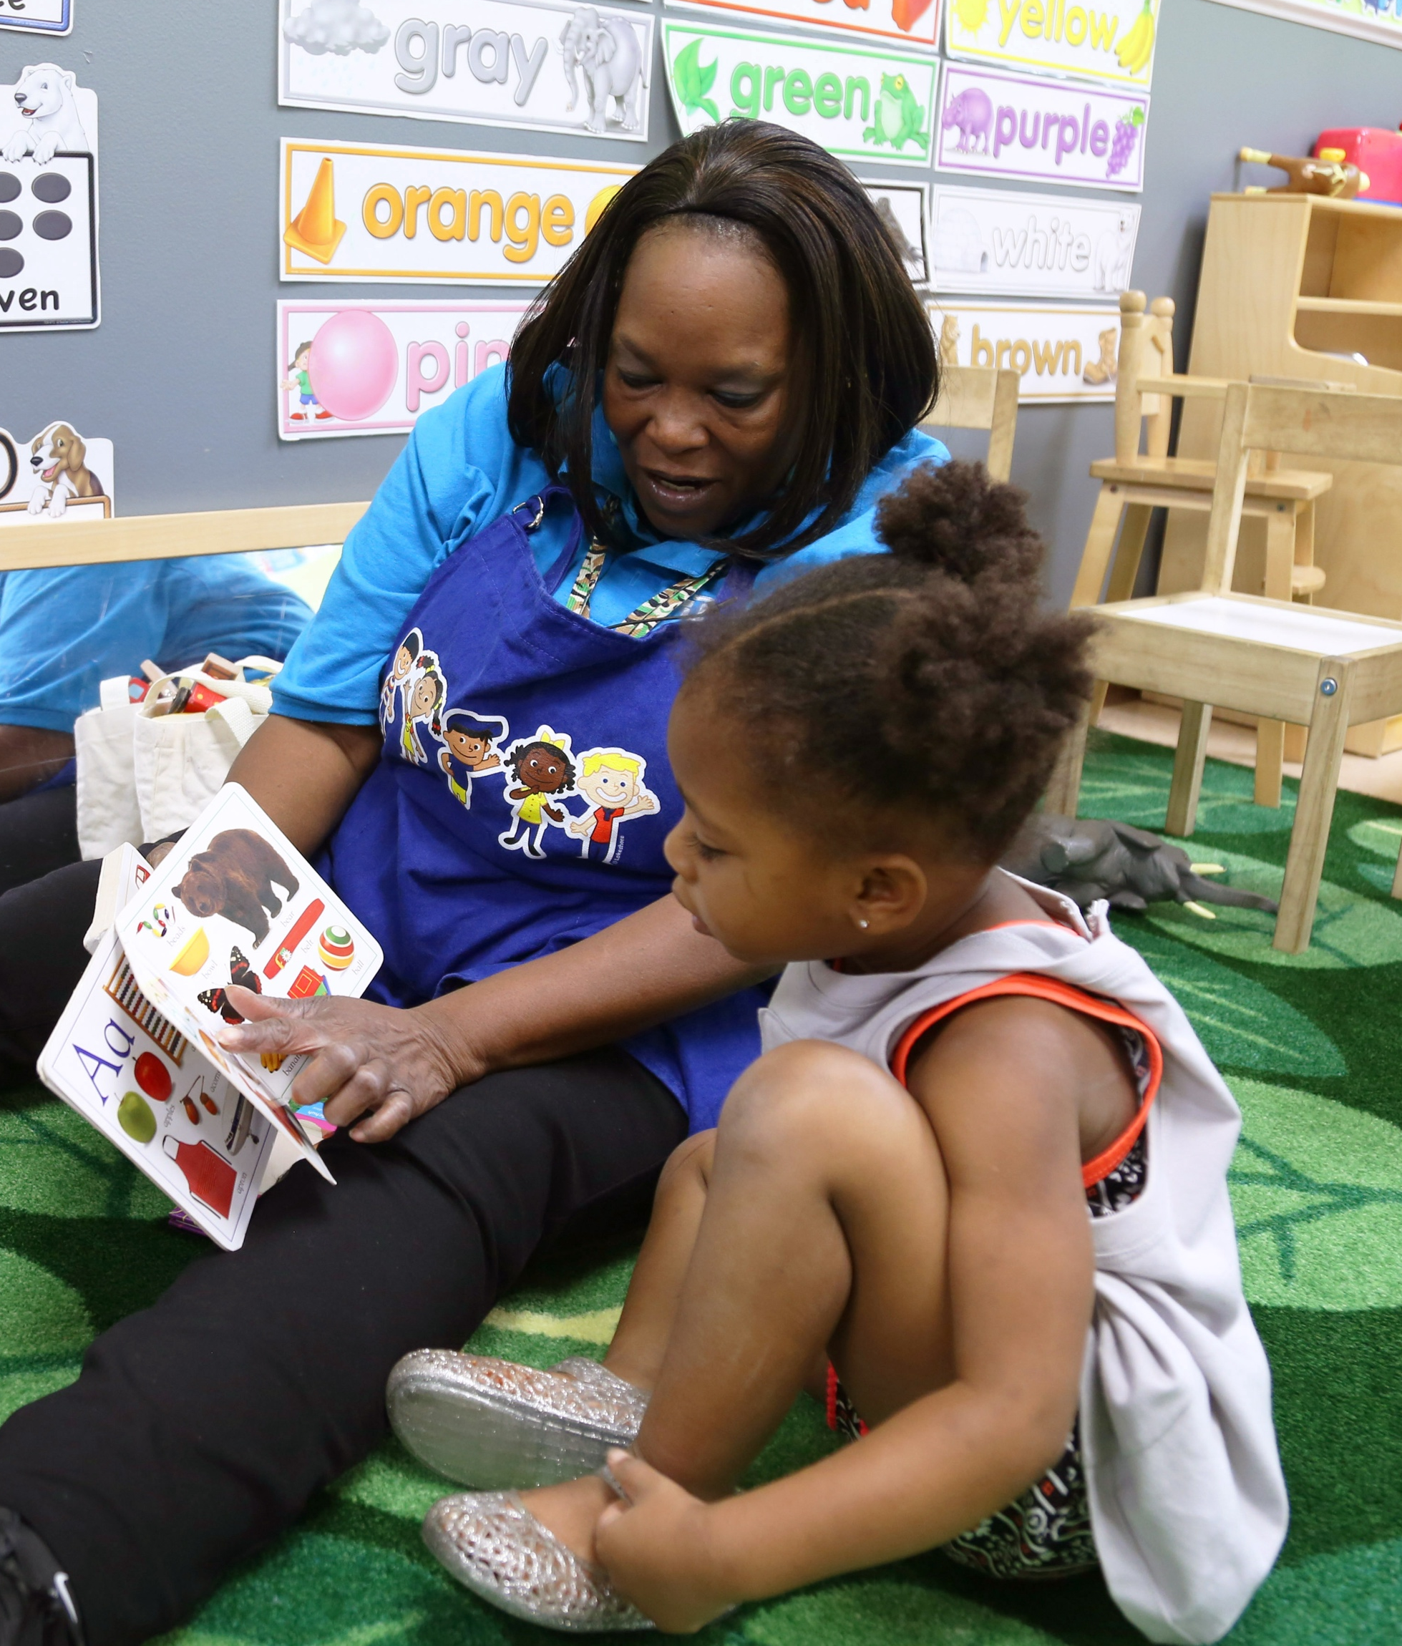
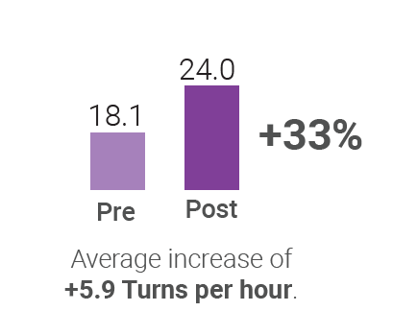
Program Outcomes
Conversational Turns
Replace or delete!
Notes:
Showcase any positive outcomes from your program's Impact Report.
This first graph focuses on conversational turns and includes all children who participated.
For those of you not familiar, a conversational turn is a simple, back-and-forth alternation between a child and an adult. We track conversational turns because they are one of the most predictive metrics of child outcomes.
At the beginning of the program, our children were experiencing <insert number> conversational turns per hour, but by the end of the program, they were experiencing <insert number> of turns. This is an average change of <insert number> %
Highlight any other areas of interest from this section of your Impact Report.

Slide 12
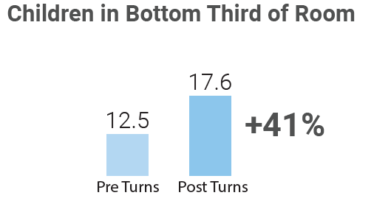
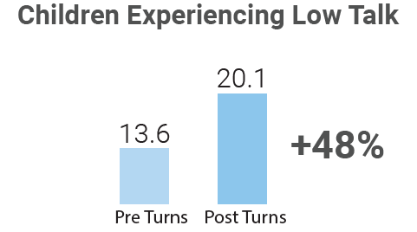
Program Outcomes
Notes:
Showcase any positive outcomes from your program's Impact Report.
Research shows that children who participate in more back-and-forth conversations during the first few years of life are better off as teenagers — with greater potential for continued success into adulthood.
LENA Grow is designed to encourage more equitable talk environments. Two segments of children measure this impact.
Children who started out experiencing less talk compared to other peers in their classroom had an average increase of <x> turns per hour.
Children who who started out experiencing less talk than the national median of 15 turns per hour had an average increase of <x> turns per hour.
Highlight any other areas of interest from this section of your Impact Report.

Slide 13
Program Outcomes
Notes:
This is our Celebration Report! It summarizes the success for each classroom. For this classroom, you can see…
If you do not wish to include the entire report, we recommend taking screenshots of three key areas:
Adult Words and Conversational Turns counts (found in the lower left-hand corner of the report).
“By the end of the program…” circle graphs for both 5 and 15 turns per hour (found on the right-hand side of the report).

Slide 14



Additional Points of Pride
Equity
<Insert a program feature that promotes equity: among students, among staff, within the classroom, or your school community.>
Innovation
<Insert a program feature that shows innovation: how did using LENA Grow bring about new ideas in your community?>
Community
<Insert a program feature that shows continued community reach: inside or outside of your school community.>
Notes:
What other successful program outcomes can you feature?
Provide context by sharing relevant details to help the audience gain insights that can promote action.
Try to add an example for each of the following: one that promotes equity, one that features innovation, one that features continued community reach beyond the LENA Grow program.

Slide 15

<Additional quote from coach, teacher, other LENA Grow staff, or parent/family>
<Name of staff member>
<Job title/position>
Replace or delete!
Notes:
Sharing stories helps stakeholders connect with your data. Use additional quotes, stories, or even videos from teachers, parents and families, coaches, and center directors to show program impact at a more personal level. Share how LENA has changed your community for the better!
Copy this slide to include as many quotes and stories as you need!

Slide 16
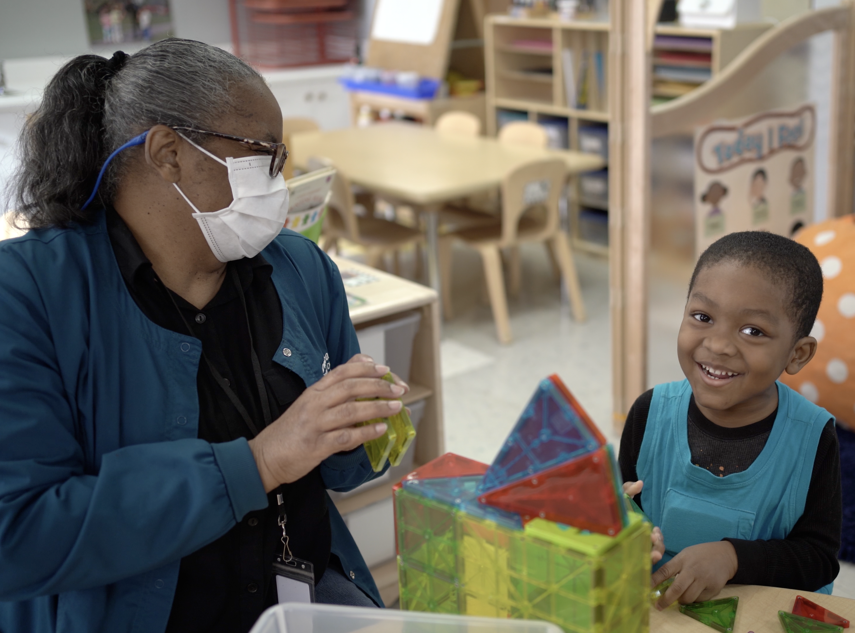
Ongoing Impact
Impact of programming continues to increase as each caregiver applies what they learned in LENA Grow throughout their career.
Notes:
Because LENA focuses on behavior changes around early talk for caregivers, the impact of programming continues to increase as that caregiver continues to use learned skills outside of official LENA cohorts with additional children.

Slide 17
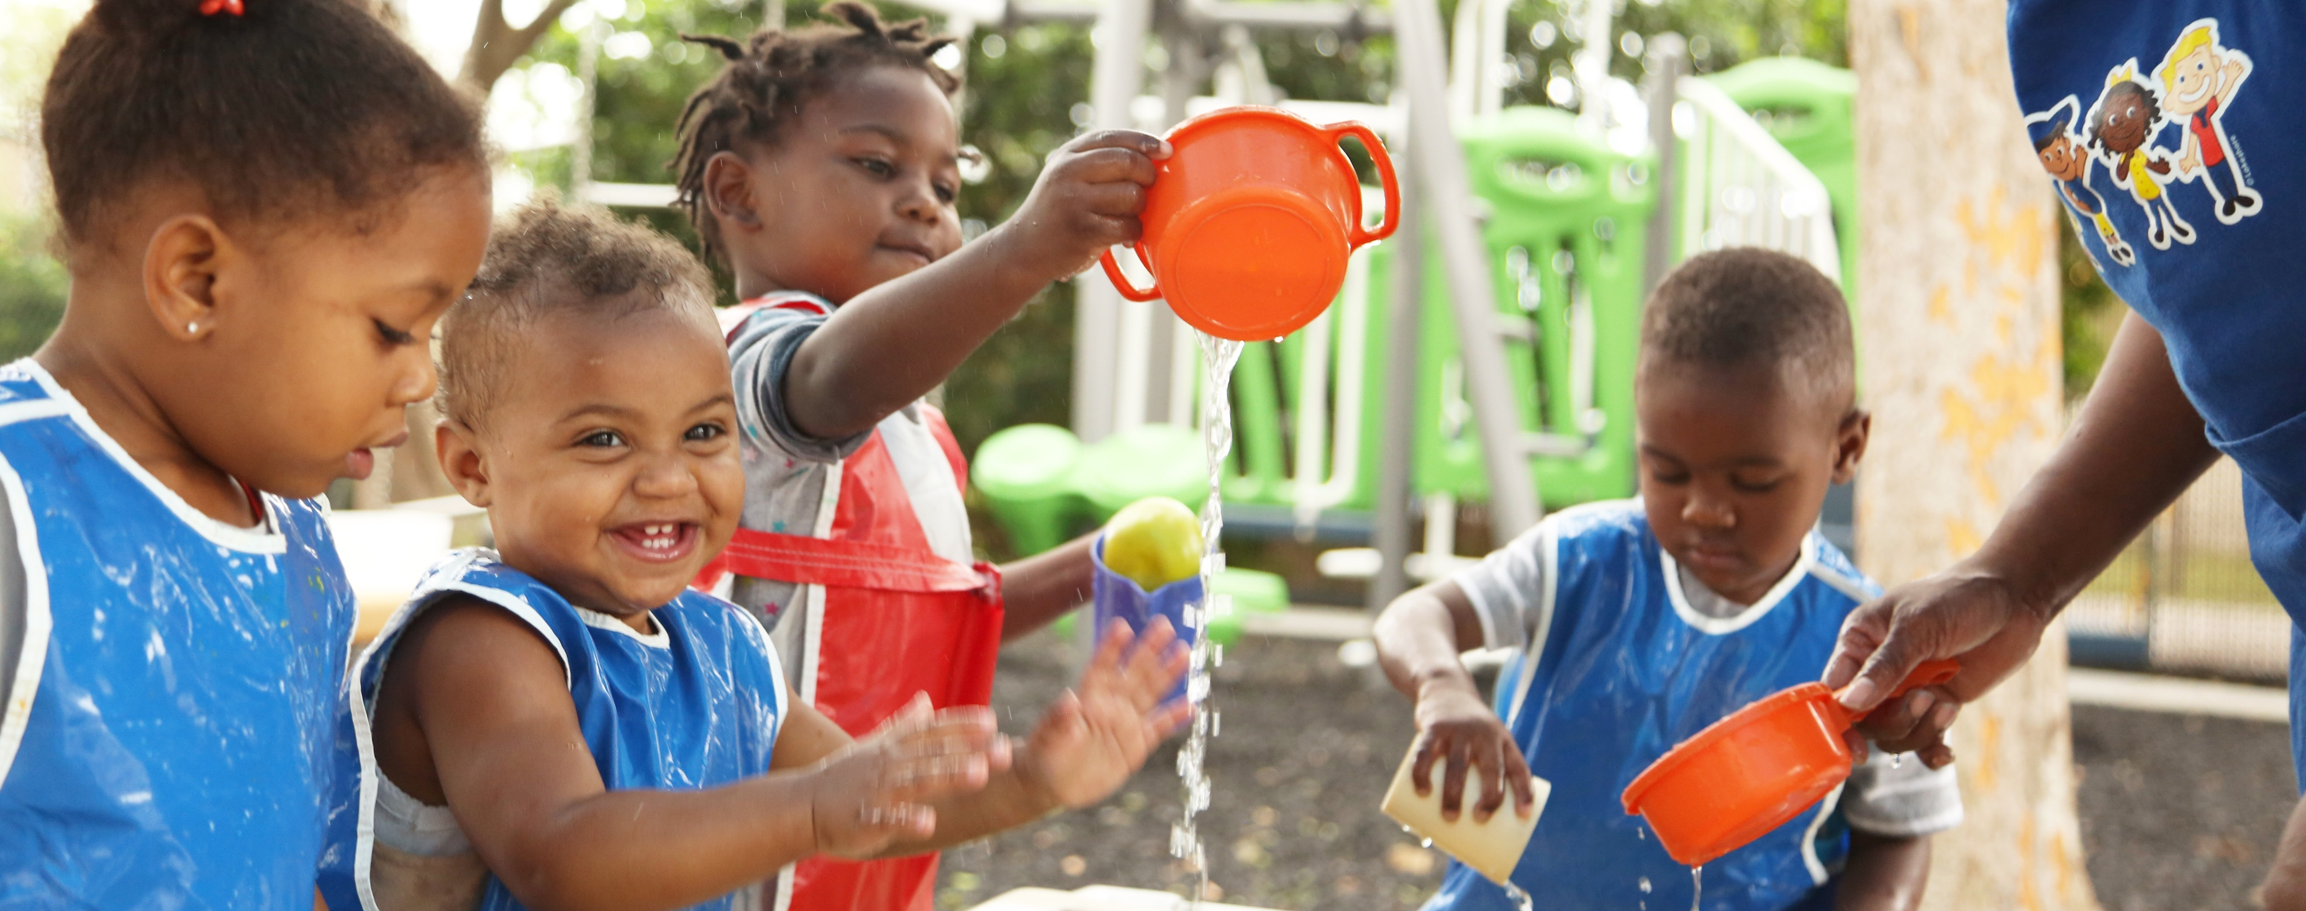
Notes:
We are thrilled to continue to offer LENA Grow to our community. We have seen such a big change in our children, educators, and community as a whole.
Quality early-childhood programs such as ours can yield a seven-fold return over participants’ lifetimes.
Nobel Prize-winning economist James Heckman
High quality early childhood programs can yield a $4 - $9 dollar return per $1 invested.
National Forum on Early Childhood Policy and Programs

Slide 18
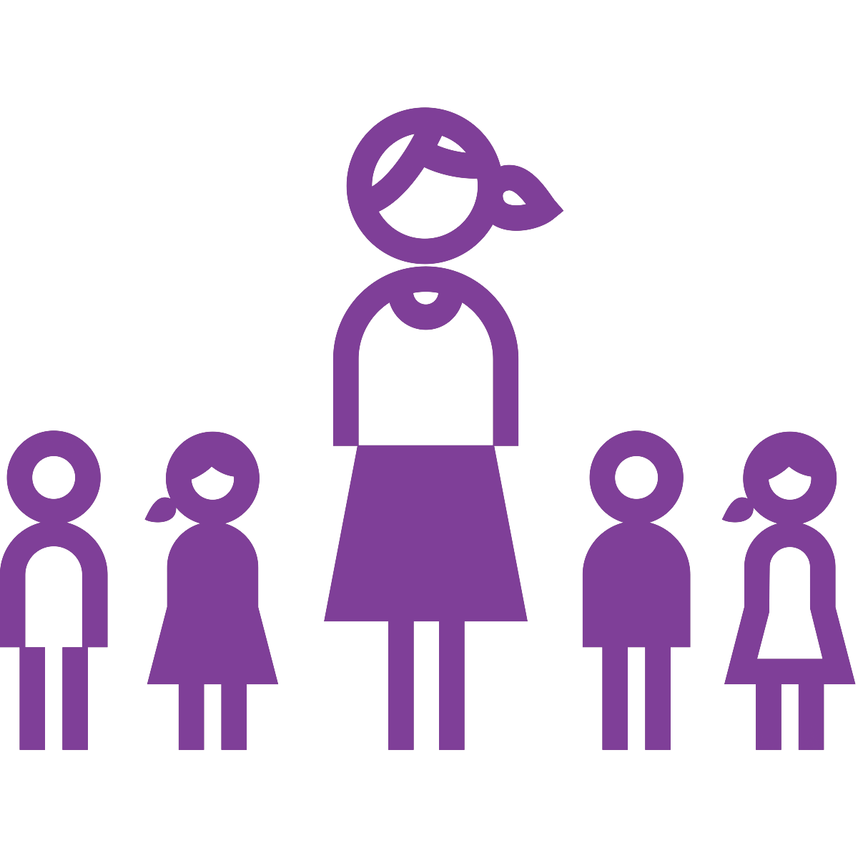
You can help!
Your support will offset the <startup> costs in <Year 1>.
Your funding will…
Impact <100> children.
Support <10 teachers> in the upcoming year.
Notes:
Use this slide if presenting to a funder or potential funder. Customize this slide to include other types of support based on your audience. Examples include: Teacher incentives, classroom materials to support interaction, etc.
We need your help to continue to offer LENA Grow to our community. Your support will offset the <startup> costs in <Year 1> required to purchase program materials and build capacity within our organization to implement LENA.
Your funding will impact <100> children and support <10 teachers> in the upcoming year.

Slide 19
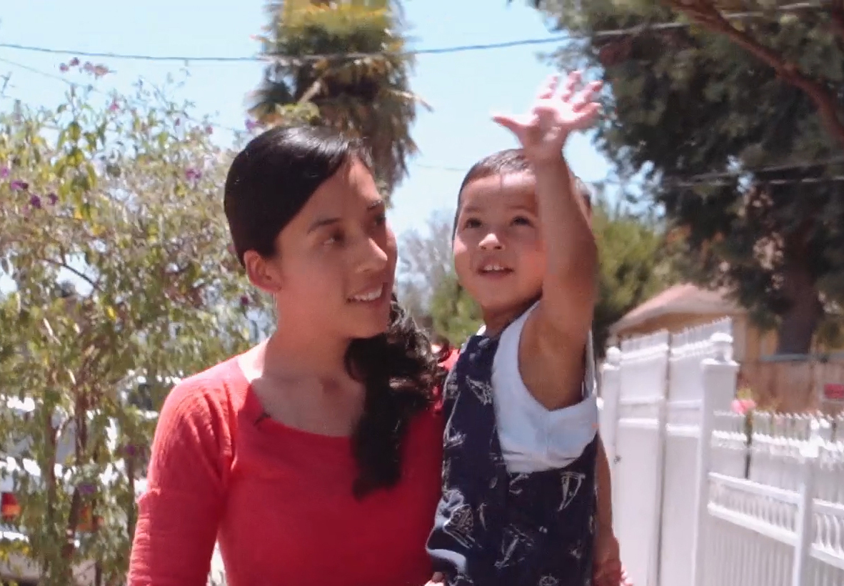

Thank you!
Notes:
Thank you!
With your continued support, we look forward to learning more with LENA, and supporting teachers, families, and children in making every interaction count.

