Slide 1
Bringing LENA Grow to Your Center
Notes:
Preparation:
Have a LENA Device and LENA clothing on hand to show the technology firsthand.
Hang a Talking Tips poster where your audience can see it. If presenting virtually, hang it behind you so it can be seen in the video.
Time:
This presentation should take no more than 20 minutes. If you need to shorten it, we recommend skipping the videos.

Slide 2
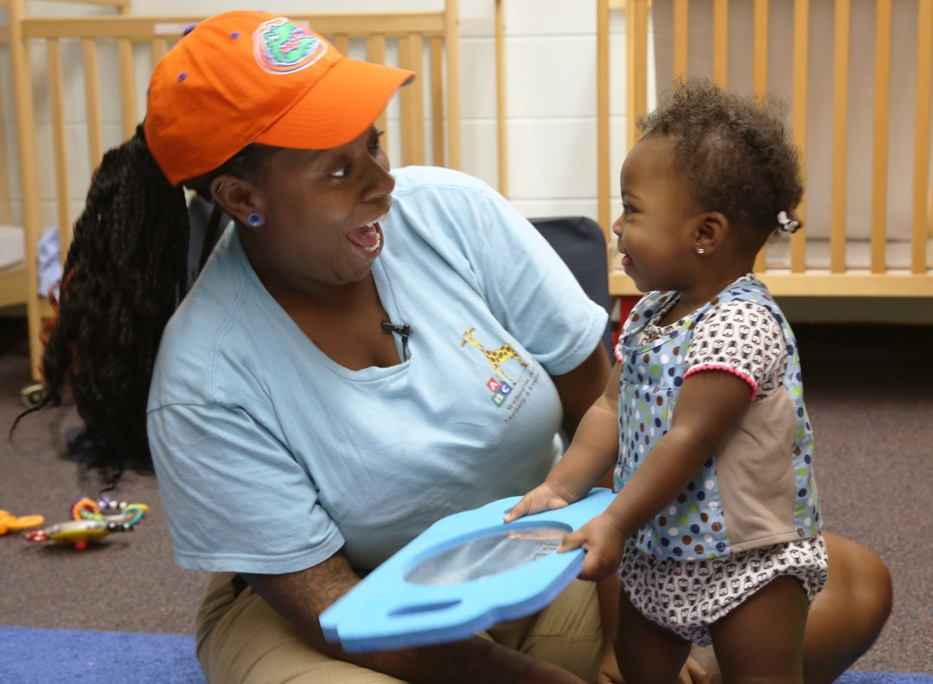
Why is early talk important?
Helps children learn and grow through:
Increased adult/child interactions.
Intentional engagement.
Notes:
LENA Grow is all about the interaction between adults and children. These interactions, or back-and-forths, are important because they help children learn and grow. LENA Grow helps child care professionals learn to be more intentional about how they engage with the children in their care, thus promoting brain development.

Slide 3
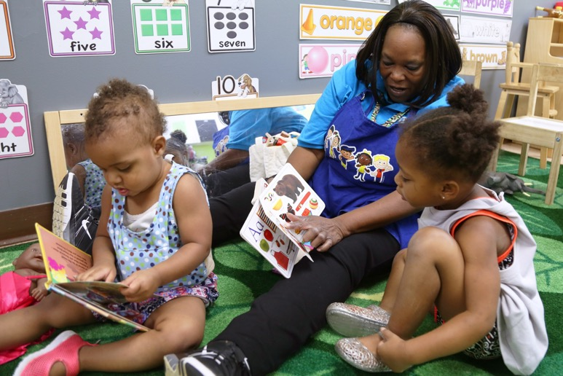
How will LENA Grow benefit our center?
New/more words from children
Increased teacher confidence
Stronger adult-child relationships
Children better able to express needs, feelings
Fewer challenging behaviors
Notes:
Children who have participated in LENA Grow have seen the following benefits:
Saying more words and saying new words
Increased confidence
Stronger relationships with their teacher
They are better able to express their feelings and needs, which can lead to fewer challenging behaviors

Slide 4
What Teachers Say About LENA Grow
At the end of the program, participating teachers report:
More confidence in teaching abilities
Higher job satisfaction
94%
93%
93%
92%
93%
92%
Notes:
This can work in your current situation. Even during COVID, teachers say participating in the program helped them feel more confident in their teaching abilities and reported higher job satisfaction by the end of the program.

Slide 5
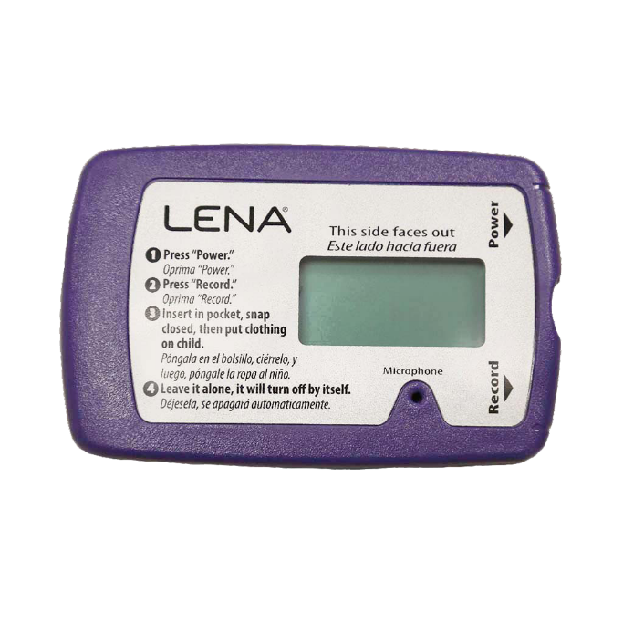
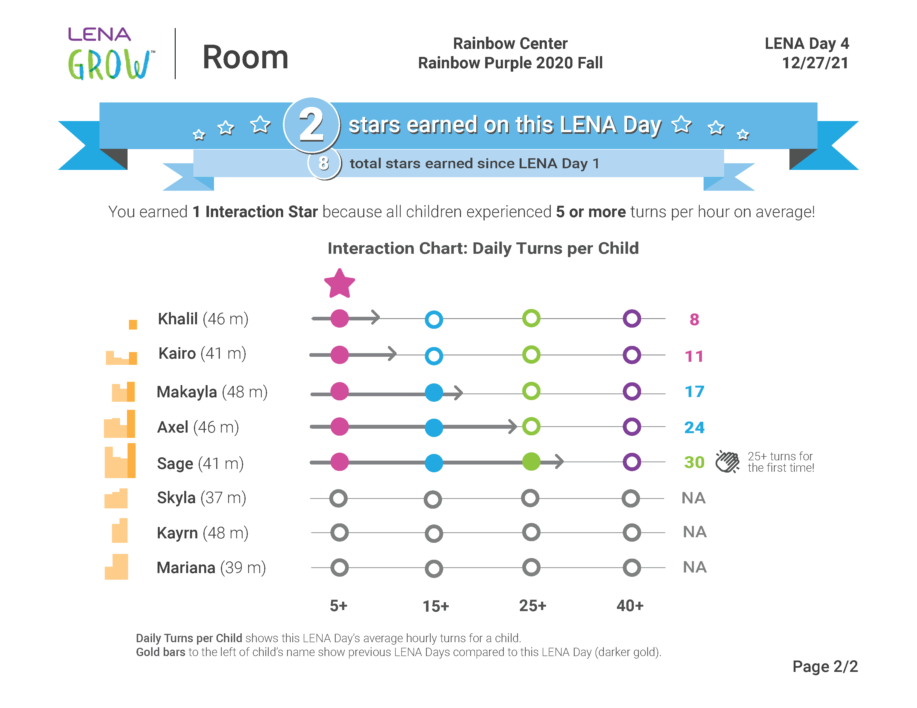
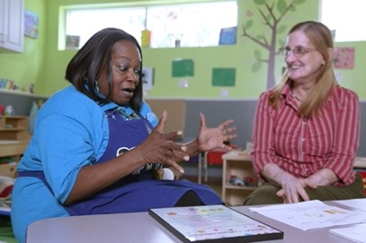
How does LENA Grow work?
Talk pedometer
measures talk
Reports
show children’s talk experiences
Coaching
supports teachers
Notes:
LENA Grow consists of 5-week sequences that give teachers data about how much they are talking with each child in their classroom.
During each “LENA Day,” all participating children wear a LENA device, which is like a talk pedometer, to capture their individual language or talk experiences throughout the day.
Then, LENA software counts words and conversational turns and creates feedback reports about the day.
Teachers will have a chance to review reports weekly with their coach, learn tips to increase back-and-forth talk with children, and set goals.
You will also get to see reports and receive ideas (Talking Tips) to help spark more interactive talk at home.

Slide 6
What Teachers Say About LENA Grow
Notes:
Introduce the video by saying, “Now we’ll have a chance to hear from real teachers who have completed the LENA Grow program.”
Watch, then discuss, “What Teachers are saying about LENA Grow” video.
If you have teachers who have been through the program, this is great time to let them share their experiences, too.

Slide 7
What do you need to provide?
We provide: | You provide:
Group Orientation session for teachers | 1 hour for teachers to participate in Orientation as a group
Coaching for teachers and consultation with center directors | 30 minutes per week for 5 weeks for teachers to participate in coaching sessions
Teacher and family engagement materials | Support for family engagement
LENA’s “talk pedometer” technology | LENA device processing on a Windows computer
Reports for teachers, families, and directors | Support for teachers on their “LENA Days”
Notes:
Customize the table above based on what you will provide versus what the center will provide. For example, if you will provide the computer or help the center process, make sure it's clear who will do what.

Slide 8
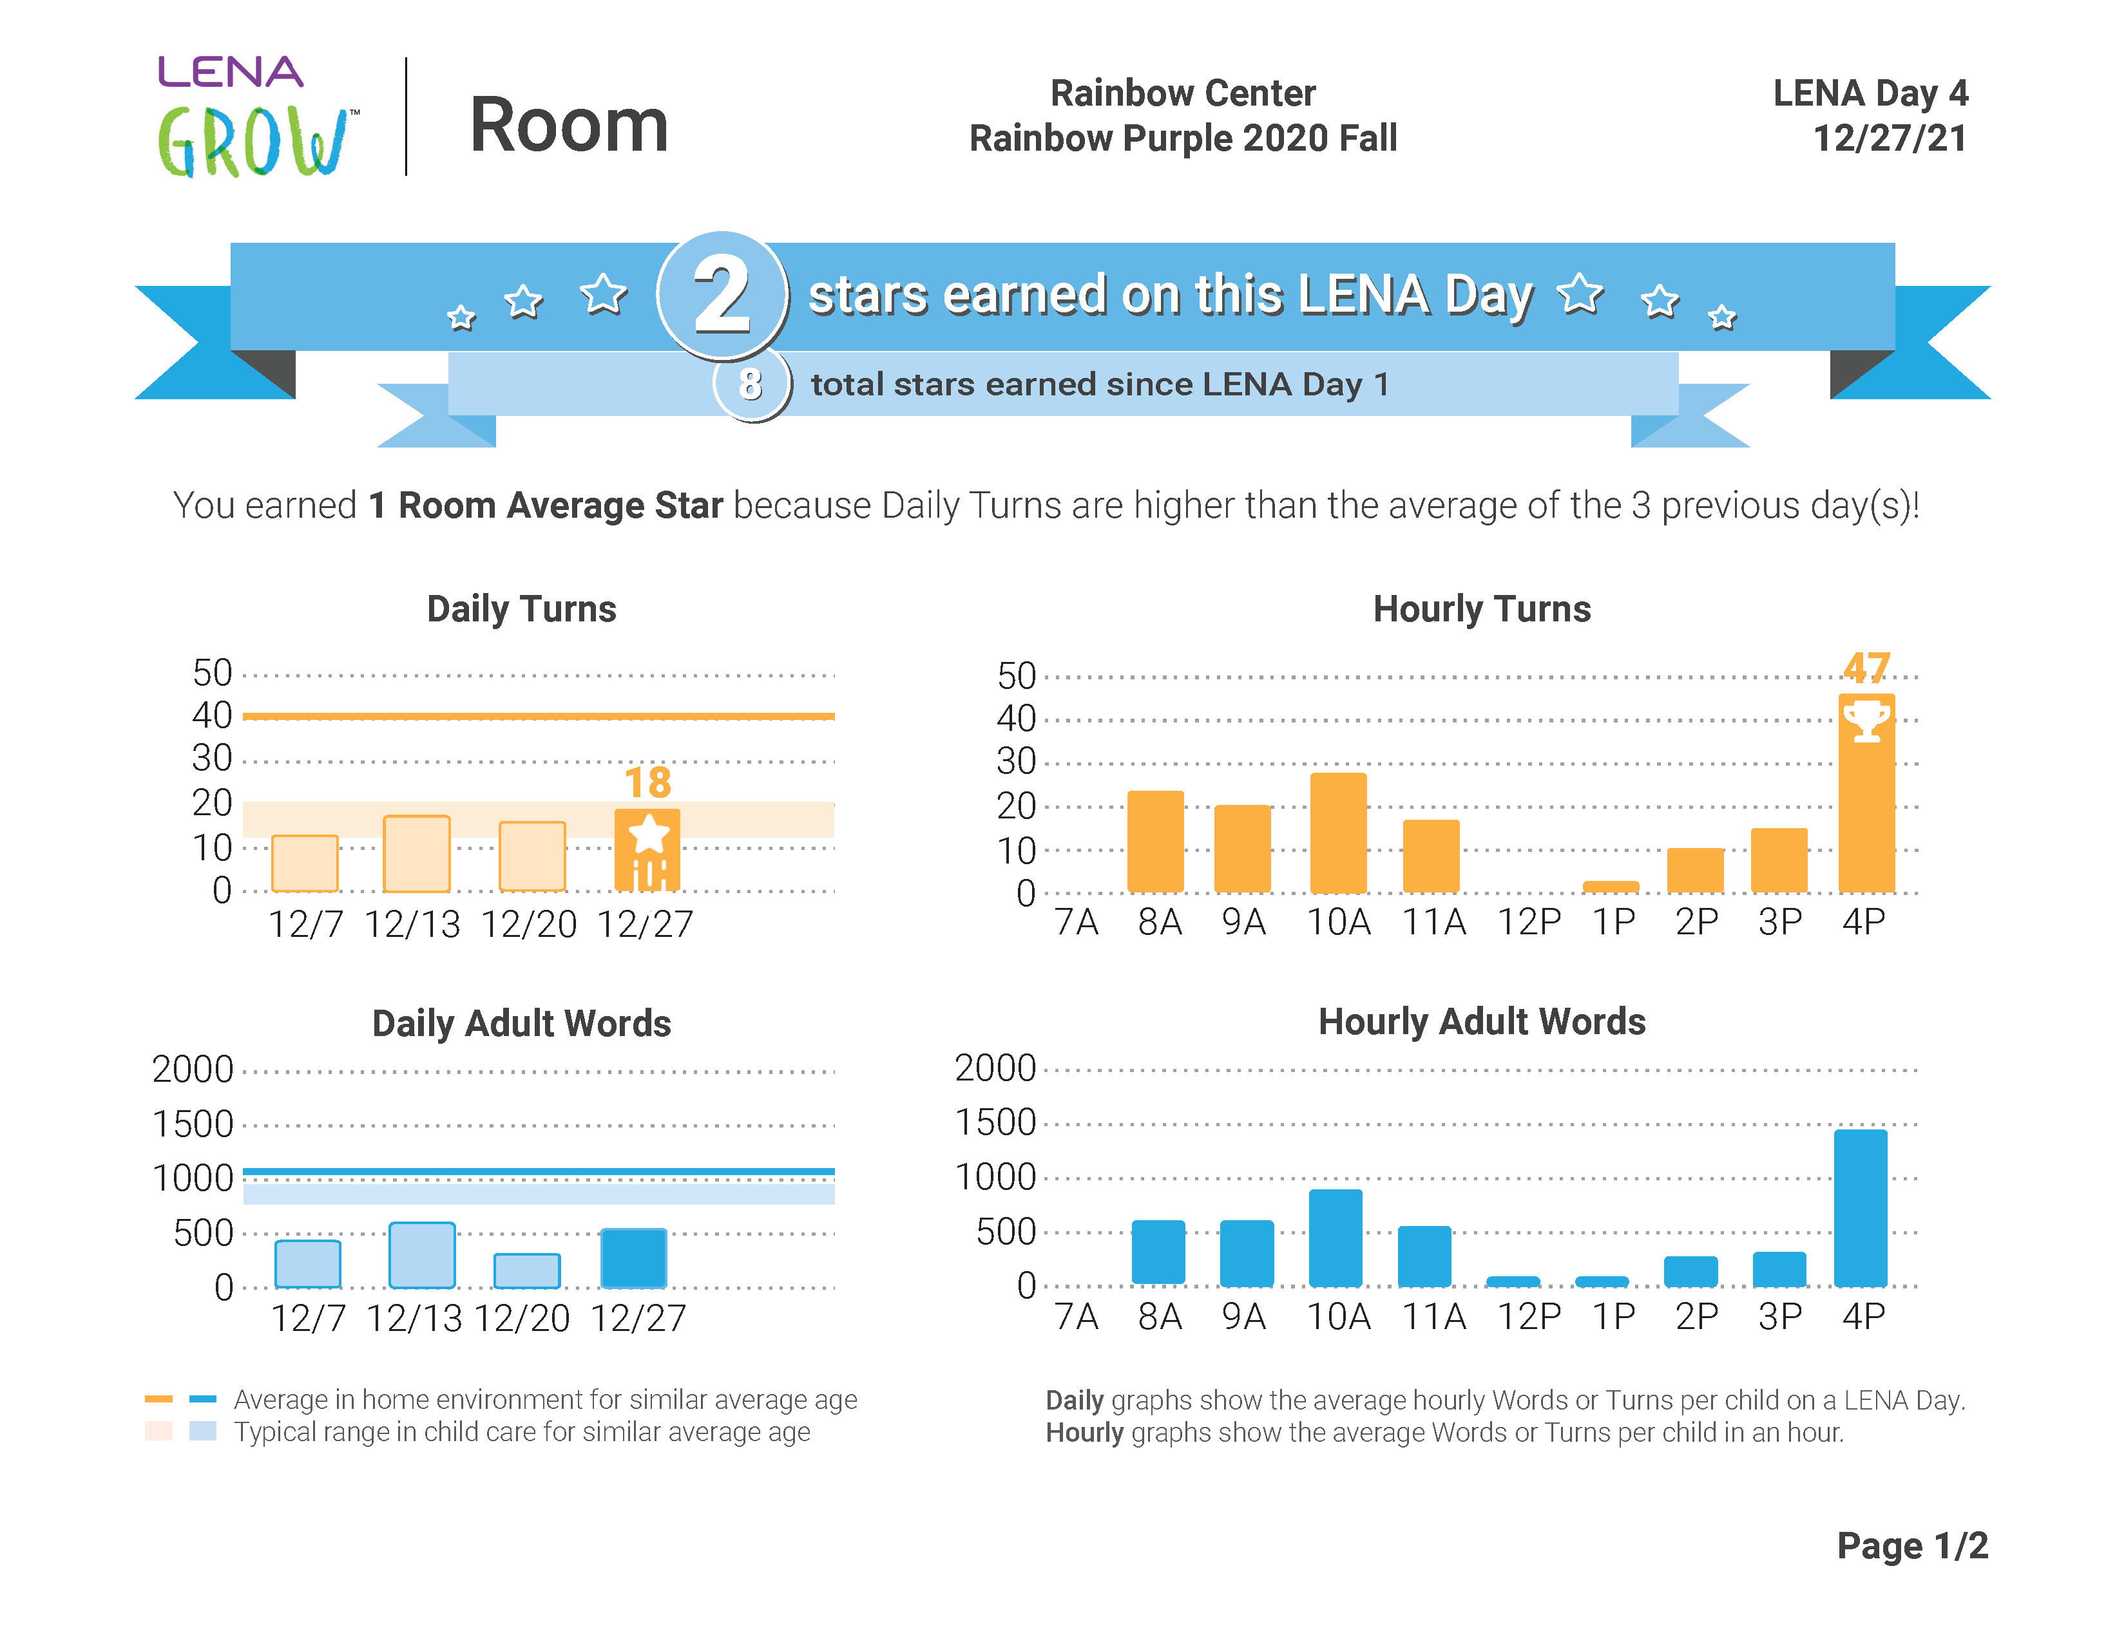
Privacy Features
Audio is deleted right after words and turns have been counted.
No one can ever listen to it.
No one knows what’s being said or the meanings of words.
Counts are turned into a report.
Notes:
Read the slide
You can compare how LENA works to sitting in a restaurant next to a family that’s speaking a language you don’t know or understand — you just know when they are talking, but you don’t know what they’re saying.

Slide 9
Questions?
How will I introduce my teachers to the program?
How will parents learn about it?
How long does the program last?
Notes:
Some FAQs:
Why is the school or center doing this?
Since conversations (turn-taking) are key to nourishing early brain growth, we’re measuring them in the classroom to learn how talk can enhance the quality of the language and literacy environment.
Can parents learn how to do this at home, too?
Yes! We're all working together to build children’s brains through interaction! We’ll provide Talking Tips and other resources to send home with families so they can learn along with teachers. If you also have LENA Start (parent-group sessions) offered in your program or community, share information about how to register to participate in the program with other parents and measure interaction at home.
Why do we need the clothing?
We want to capture all the turn-taking experienced by the children, so the LENA clothing goes everywhere they go all day. To accurately measure a child’s speech, the LENA device has to be worn in a fixed position near the child’s mouth. The clothing is carefully designed for this purpose.
Is it safe for the child?
Yes — completely. LENA devices are safe for young children, have been in use around the world for more than a decade, and have even been used with premature babies in Neonatal Intensive Care Units [change to hospitals?] for several years. Unlike cellphones, the LENA devices do not transmit (so, no Bluetooth). They use the same kind of very low-power processors as hearing aids.
Can anyone listen to what is happening in the classroom?
No: The recordings are deleted immediately after LENA has finished counting words and turns. There is no way for anyone to ever listen to the recording.
What about privacy and security?
LENA meets very strict confidentiality and data security requirements. Learn more at LENA.org/privacy-policy.

Slide 10
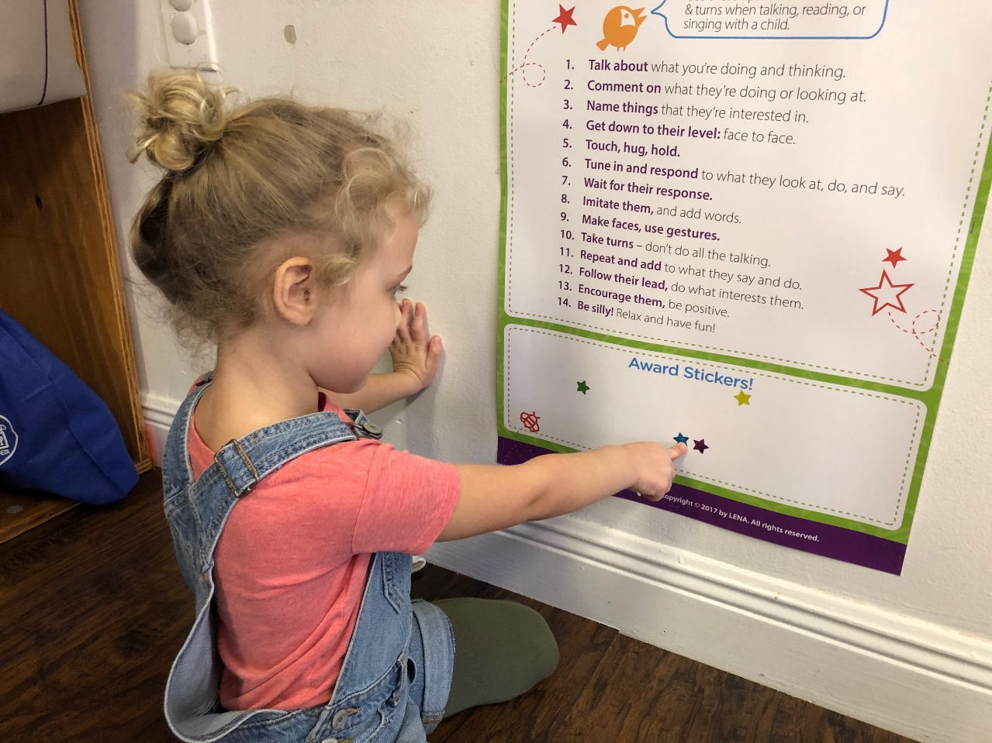
What’s next?
Select rooms/teachers you'd like to participate.
Plan a date for Orientation.
You will have a chance to learn alongside us!
Notes:
Next, you will want to select the rooms and teachers you would like to participate in LENA Grow and plan a date for your teacher Orientation.

Slide 11
Resources
Technology
How LENA Technology Works
About the Program
What are Conversational Turns?
LENA Grow Overview and Impact Report
Alignments
LENA Grow in Head Start
LENA Grow in School Districts
LENA Grow Increases CLASS® Scores

